Slide 1
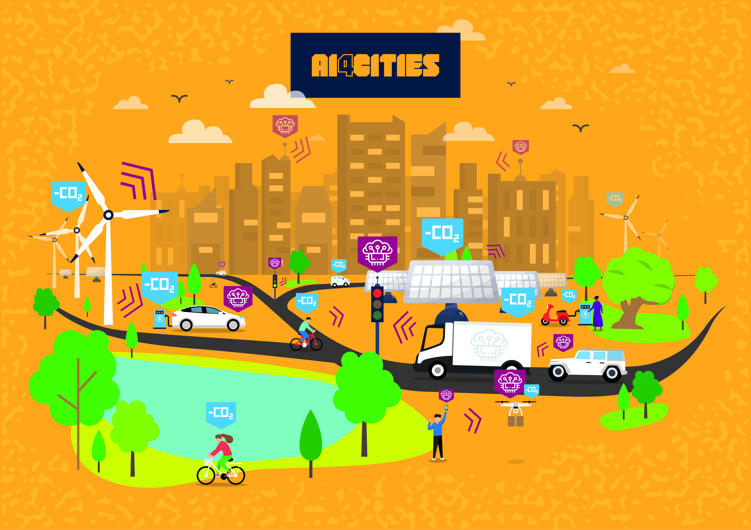
Accelerating carbon neutrality
Ai4Cities kick-off webinar Phase 2 Name, organisation: Tim Ward, CTO, Kentyou

Slide 2
Innovative startup providing an urban data platform with advanced data analytics
Target sub-challenges:
Mobility as a Service
Optimisation of placement of soft mobility terminals
Traffic flow optimization
Traffic and crowd monitoring, intersection and PoI "hot spots", visualisation and forecasting
Wildcard: Impact monitoring
Monitoring the environmental impact of mobility changes

Slide 3
Phase 1 activities and results – analysis of needs and user interviews

Slide 4
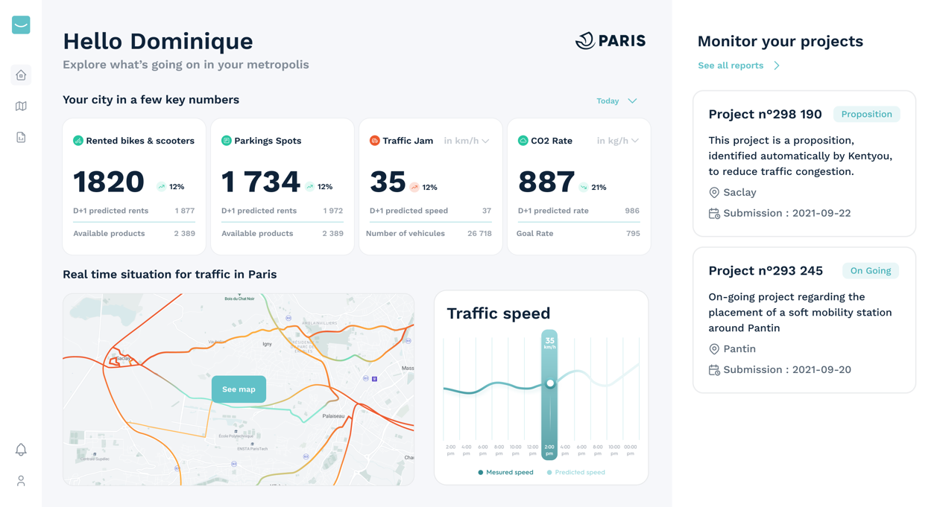
Phase 1 activities and results - user oriented solution design

Slide 5
Phase 2 plans : prototype and user tests
Main activity
Finalise the implementation of the new front-end components identified in Phase 1
Implementation of back-end changes necessary to support the new front end
End user testing and user experience validation
Main challenges
Organisational: Interact with the city users for tests
Technical: Maintaining the performance and scalability of the system as a whole when gathering time-shifted data for large numbers of sensors

